Slide 1
OA3103: Data Analysis
MLR Continued

Slide 2
Admin
Happy Virtual Friday

Slide 3
References
ISLP: Chapter 3

Slide 4
Clarification / Clean Up
R: drop = FALSE
We used this in the train/test split code yesterday for selecting a single column of data.
If we take a subset of data that consists of only one column, R likes to convert it to a vector.
This causes issues for lm() and model.matrix() because they expect data frames
x_train <- df[1:3, ] returns a vector
x_train <- df[1:3, , drop =FALSE] preserves a data frame
In other words, R defaults to drop = TRUE

Slide 5
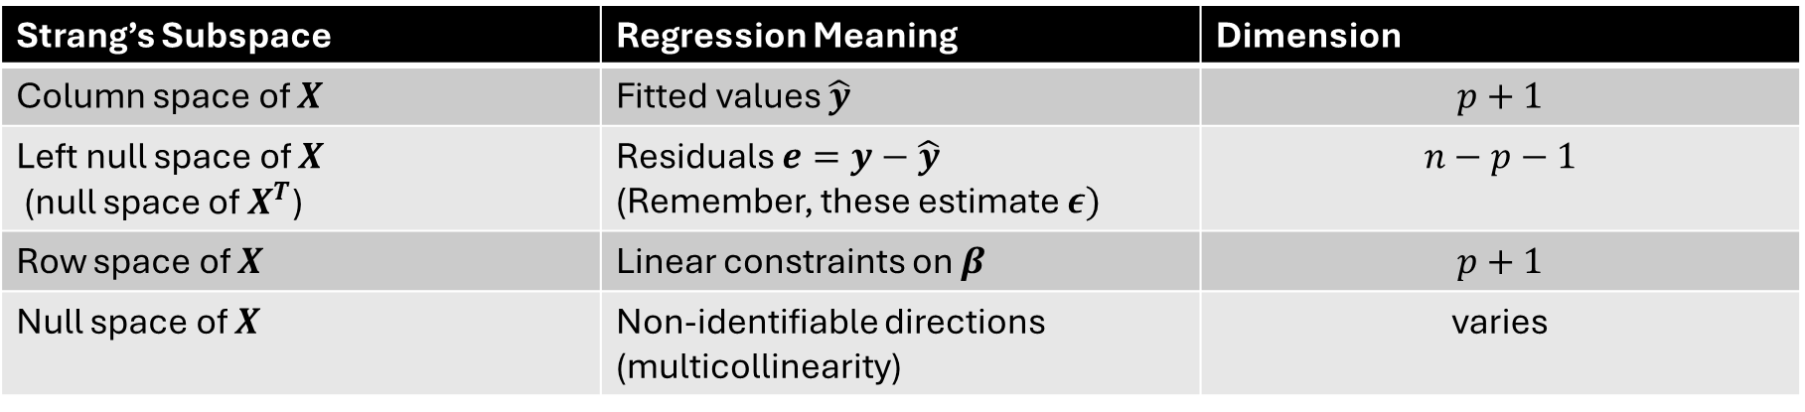

Clean Up: The “Big 4” Subspaces
Many linear algebraists (particularly Gilbert Strang) refer to four subspaces. We look at these for $X$:
Strang’s Subspace | Regression Meaning | Dimension
Column space of $X$ | Fitted values $\hat{y}$ | $$p+1$$
Left null space of $X$ (null space of $X^{T}$) | Residuals $e=y−\hat{y}$ (Remember, these estimate $ε)$ | $$n−p−1$$
Row space of $X$ | Linear constraints on $β$ | $$p+1$$
Null space of $X$ | Non-identifiable directions (multicollinearity) | varies
*See Linear Algebra and Its Applications by Gilbert Strang, as well as his MIT Open Courseware Videos for more.

Slide 6
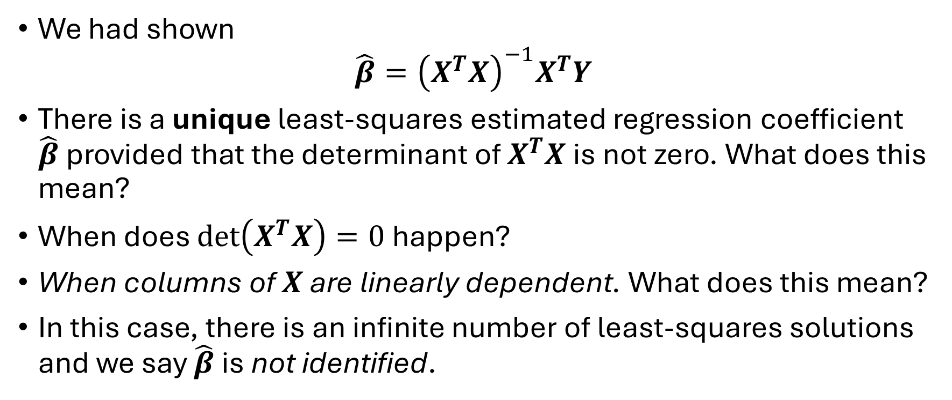
Identifiability
We had shown
$${\hat{β}=\left(X^{T}X\right)}^{−1}X^{T}Y$$
There is a unique least-squares estimated regression coefficient $\hat{β}$ provided that the determinant of $X^{T}X$ is not zero. What does this mean?
When does $\det\left(X^{T}X\right)=0$ happen?
When columns of $X$ are linearly dependent. What does this mean?
In this case, there is an infinite number of least-squares solutions and we say $\hat{β}$ is not identified.

Slide 7
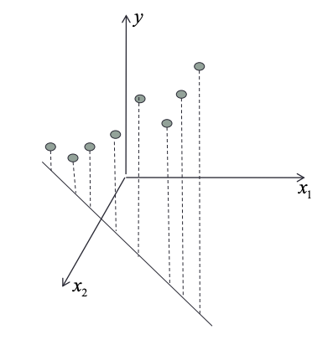

Non-Identifiability Example
Suppose we have:
$x_{1}:$ temperature measured in $℃$
$x_{2}:$ temperature measured in $℉$ $$→x_{2}=\frac{9}{5}x_{1}+32$$
$X=\left[\begin{matrix}1 & x_{1} & x_{2} \\ ⋮ & ⋮ & ⋮ \\ 1 & ⋮ & ⋮\end{matrix}\right]$??

Slide 9
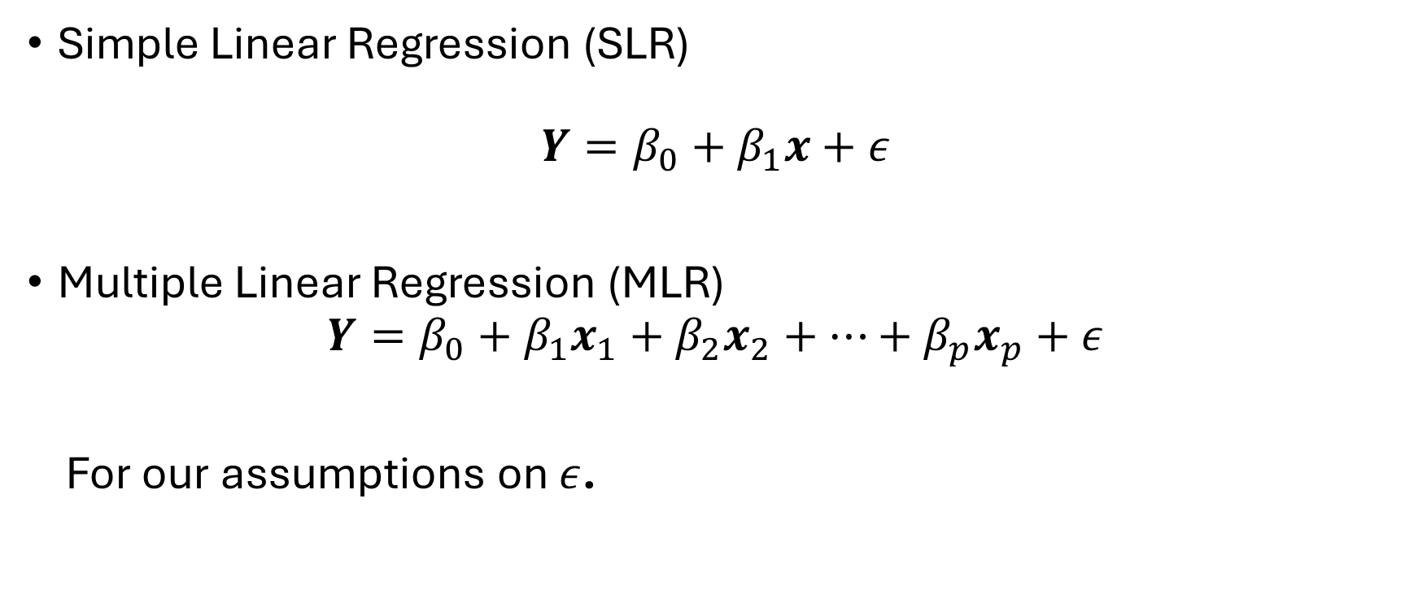
Multiple Linear Regression
Simple Linear Regression (SLR)
$$Y=β_{0}+β_{1}x+ε$$
Multiple Linear Regression (MLR)
$$Y=β_{0}+β_{1}x_{1}+β_{2}x_{2}+…+β_{p}x_{p}+ε$$
For our assumptions on $ε$.

Slide 10
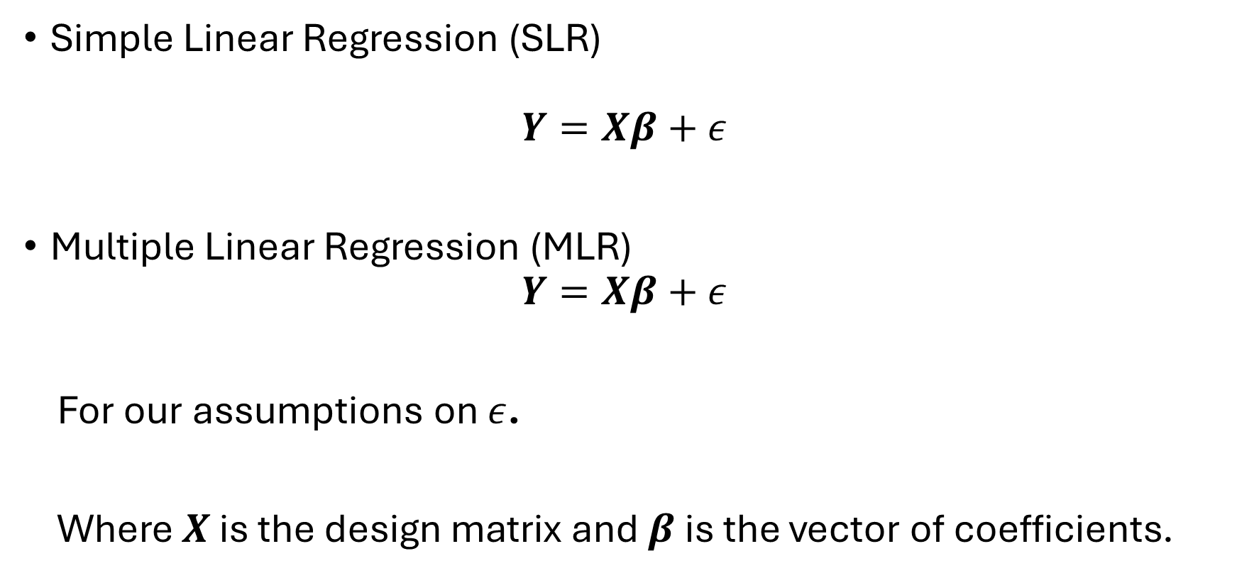
Multiple Linear Regression
Simple Linear Regression (SLR)
$$Y=Xβ+ε$$
Multiple Linear Regression (MLR)
$$Y=Xβ+ε$$
For our assumptions on $ε$.
Where $X$ is the design matrix and $β$ is the vector of coefficients.

Slide 11
What is Different?
In Multiple Linear Regression, we can have multiple predictors.
Tradeoff:
Graphics are difficult in higher dimensions.
Least squares fit is now a (hyper) plane instead of a line.

Slide 12
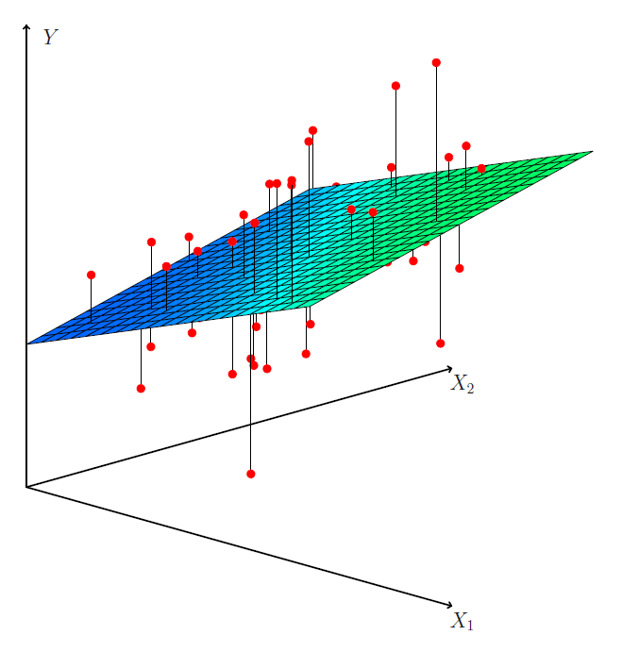
What is Different?
Least squares fit is now a (hyper) plane instead of a line.
Source: ISLP Figure 3.4

Slide 13
Let’s Look at a Dataset
Advertising.csv
Contains data on
(Selected) Response Variable: Sales thousands of units
Predictors are advertising budgets: TV thousands of dollars Radio thousands of dollars Nespaper thousands of dollars
200 different markets.

Slide 14
Some Important Questions
Is at least one of the predictors (TV, Radio, Newspaper) useful in predicting the response (Sales)?
Do all of the predictors help to explain Sales, or is only a subset of predictors useful?
How well does the model fit the data?
Given a set of predictor values, what response value should we predict for Sales, and how accurate is our prediction?

Slide 15
Start with EDA
Advertising.csv is a cleaned dataset:
> # Do any of the columns in advertising have missing values?
> colSums(is.na(advertising))
X 0 TV 0 Radio 0 Newspaper 0 Sales 0

Slide 16
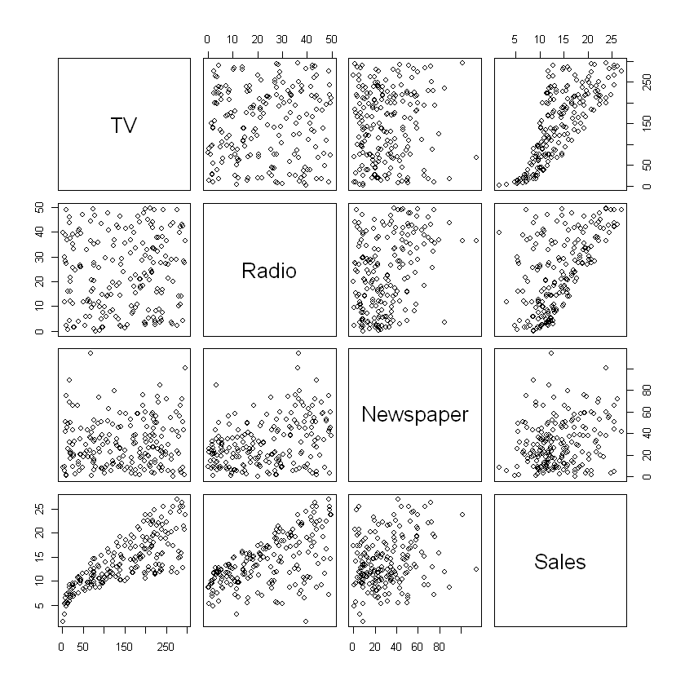
Scatterplot Matrix

Slide 17
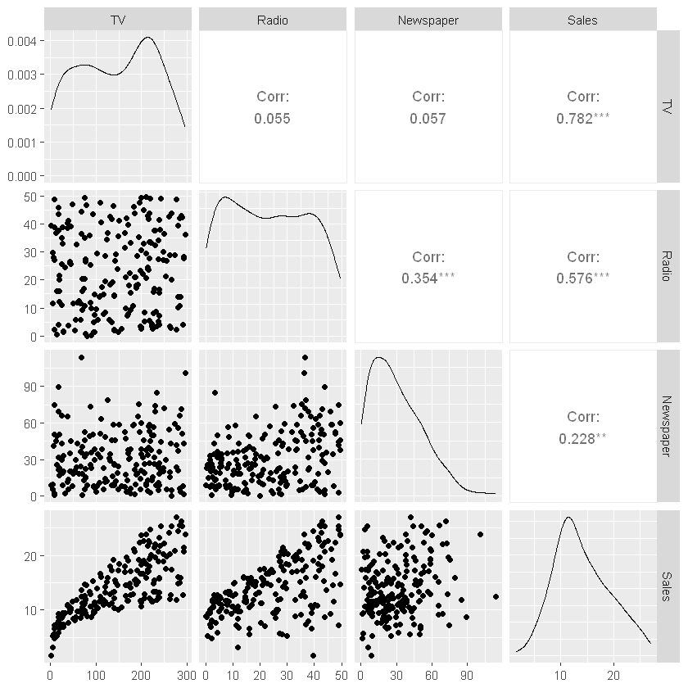
ggpairs
GGally package in R

Slide 18
Things to Note
Which predictors have the strongest correlation with Sales?
Which predictors have the strongest correlation with each other?

Slide 19
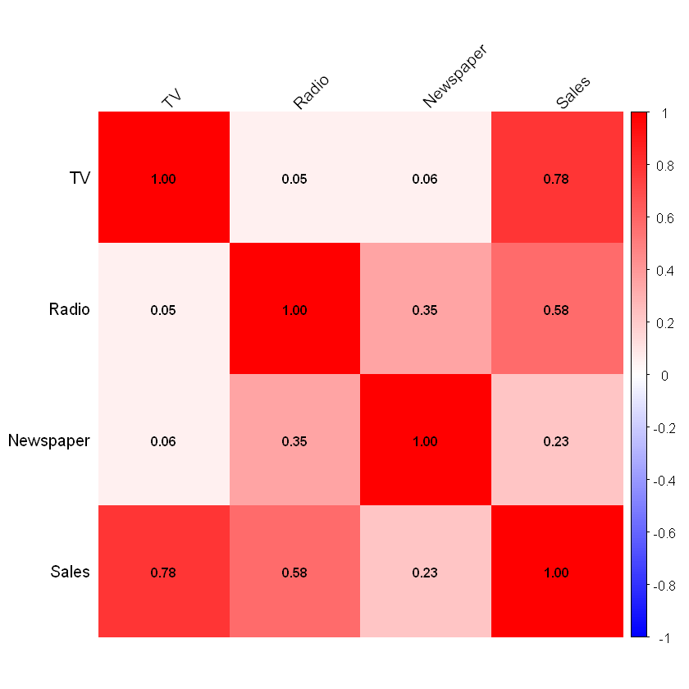
Correlation Heatmap
corrplot package in R

Slide 20
New Commands
In R, we build an MLR model with
lm(Y ~ X1 + X2 + … + Xp)

Slide 21
New Commands
In Python, we want to decide if we are doing inference or prediction.
For inference we use the statsmodels package:
import statsmodels.formula.api as smf
fit = smf.ols("Y ~ X1 + … + Xp", data=df).fit()
* When using the formula interface, we don’t need to build a design matrix manually.

Slide 22
New Commands
In Python, we want to decide if we are doing inference or prediction.
For prediction we use sklearn:
from sklearn.linear_model import LinearRegression
model = LinearRegression()
model.fit(df[["X1", "X2", "X3"]], df["Y"])
*No summary output like in R lm() or statsmodels.

Slide 23
Let’s go to R, then Python

